Slide 1
Basis sets, Relativistic corrections, Dispersion, Population analysis
Instructor: Prof. Tzuhsiung (Nick) Yang
Email: tyang@mx.nthu.edu.tw
Time: M5/6
Room: NTHU Library Comp Lab II
Notes:
Rafael Gomez

Slide 2
Suggested reading
Chapter 3 in Szabo, A.; Ostlund, N. S. Modern Quantum Chemistry: Introduction to Advanced Electronic Structure Theory; Courier Corporation, 2012.

Slide 3
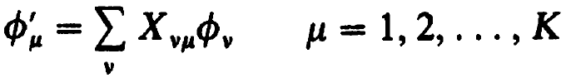
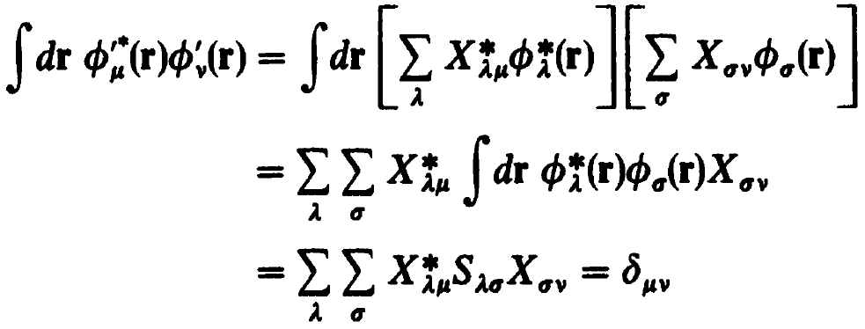
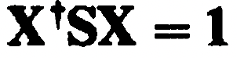
Self-consistent field
To turn S into I we can expand the basis functions
Such that the new basis is orthonormal
Or in the matrix form

Slide 4


Self-consistent field
One choice is symmetric orthogonalization
in which we first diagonalize S using unitary transformations
Then we take the inverse square root of the eigenvalues and back-transform to yield S^{-1/2}

Slide 5
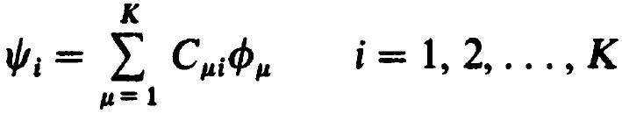
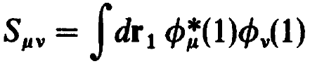
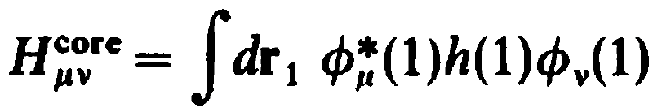
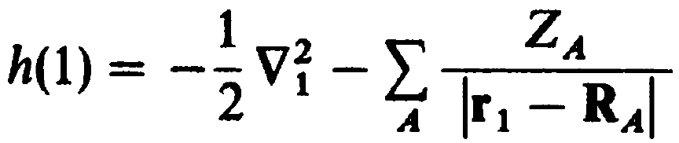
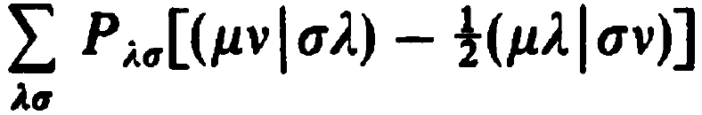
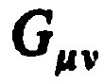
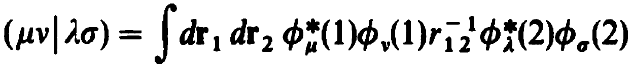
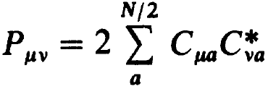
Basis sets
How do we find $ψ_{i}$: linear combination of basis functions
The integrals on the right form the overlap matrix;
The first term is called the core-Hamiltonian matrix
,
where
Density matrix for closed-shell is thus defined as

Slide 6
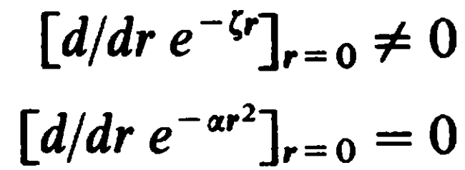
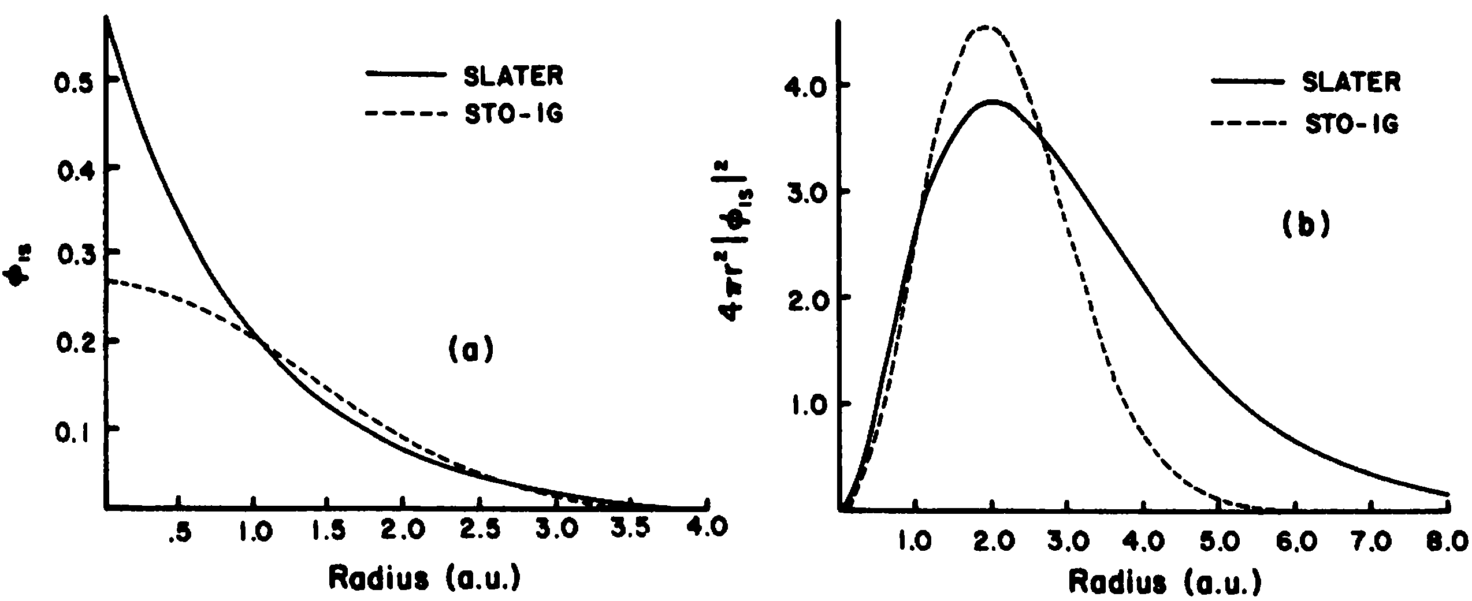
Basis sets
There are two commonly used types of basis sets:
Slater functions
Gaussian functions
The two functions differ significantly at r = 0 (cusp)
and at large r where GTOs decay too fast

Slide 7
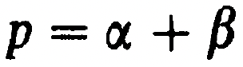

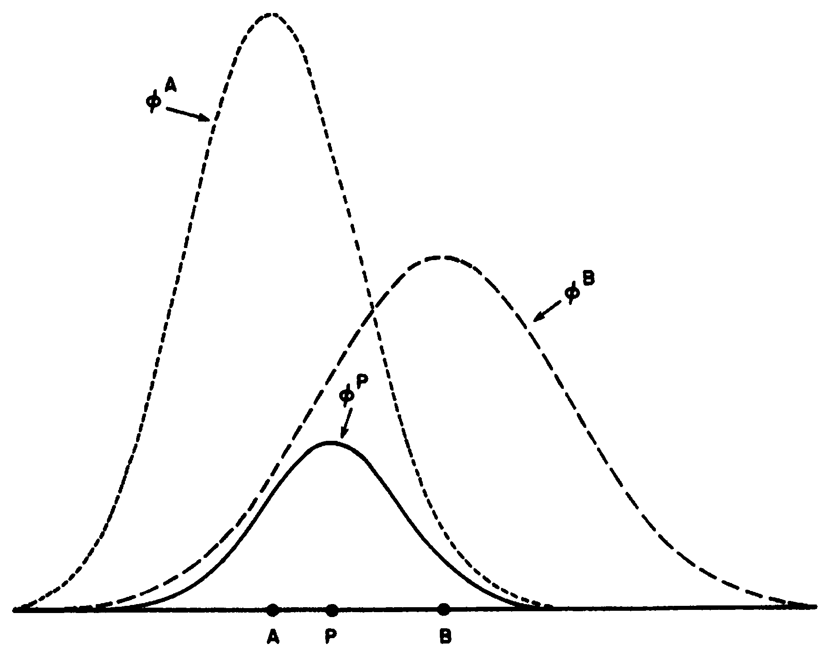
Basis sets
The advantage of GFs over SFs is the ease of integration
with the arguments being
,

Slide 8
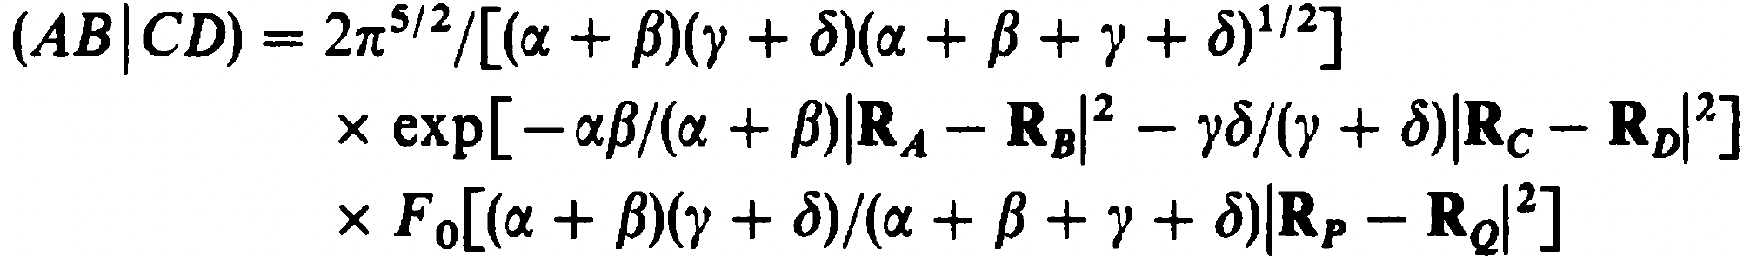
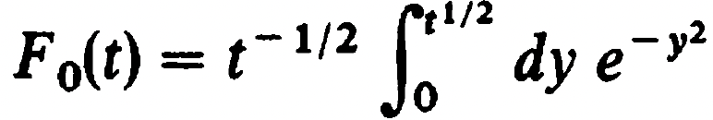
Basis sets
The two-electron integrals thus reduce to
which can be solved using Fourier transformation
See Appendix A for proof

Slide 9
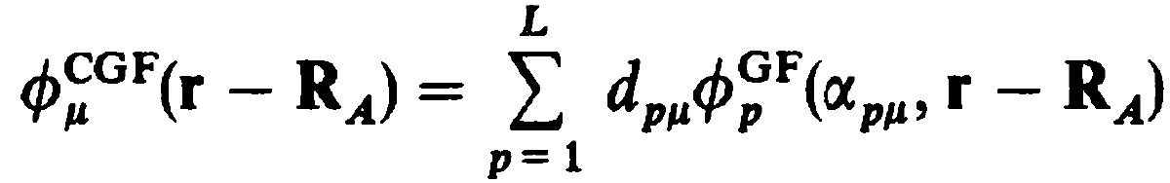
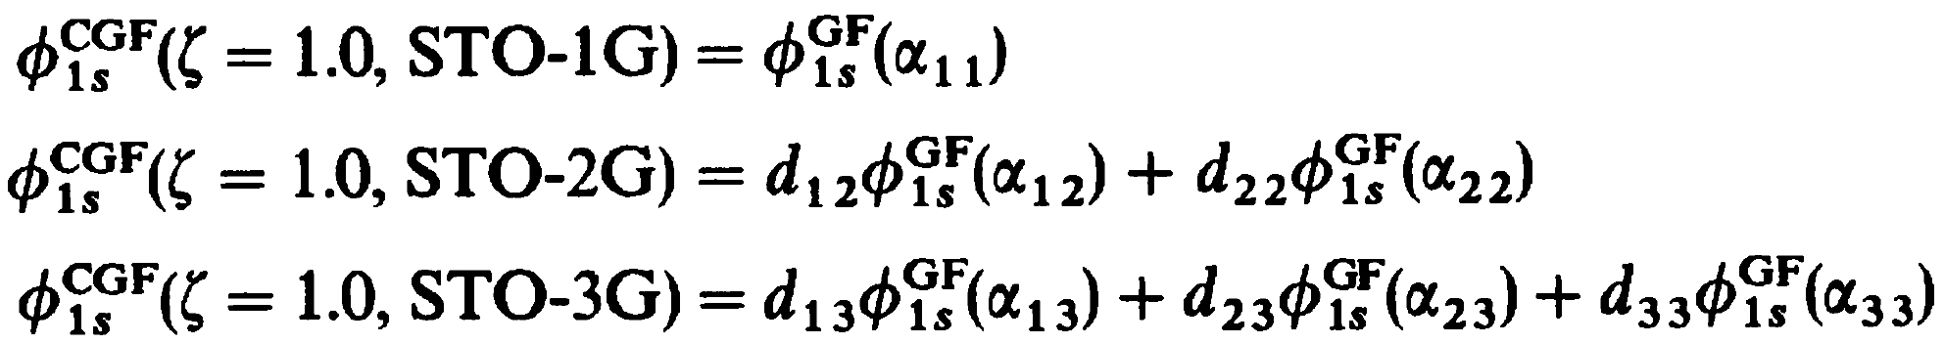
Basis sets
Since GTOs are easy to integrate yet have drawbacks, we can use linear combinations of GFs (primitives)
This is called basis set contraction and the contracted function is called a contracted Gaussian function (CGF) where L is called the length of contraction, d is called contraction coefficient, and ⍺ is called contraction exponent. We then fit these CGFs with length L (STO-LG) to STOs:
This contraction scheme for STO-3G is (3s)/[1s]

Slide 10
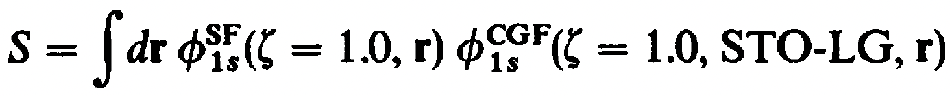
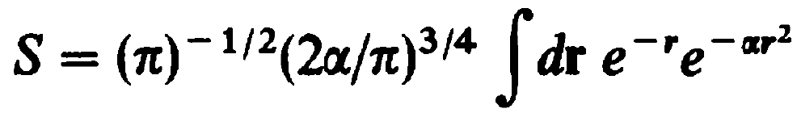
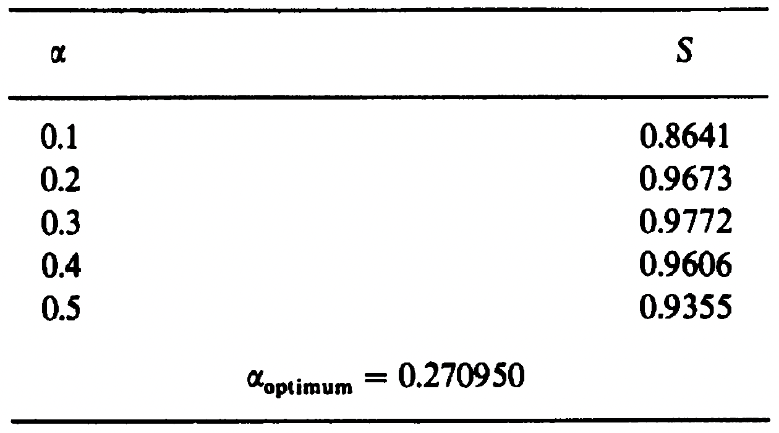
Basis sets
The fitting procedure minimizes
or equivalently, maximizes the overlap S since both functions are normalized.
For example, S for STO-1G is
and the corresponding optimal ⍺ is 0.270950

Slide 11
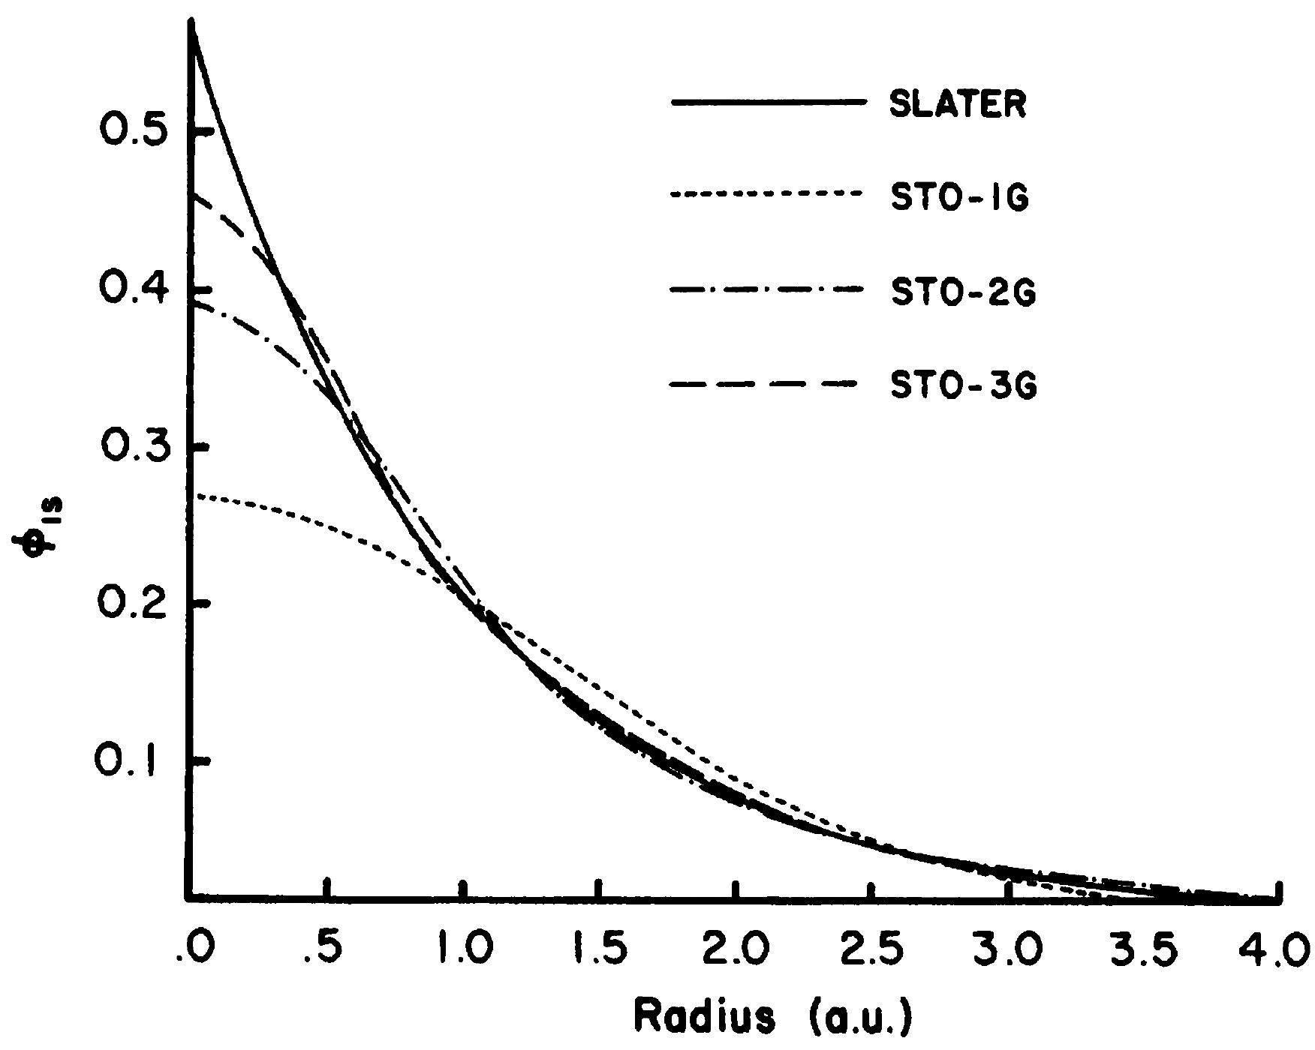
Basis sets

Slide 12
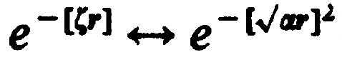
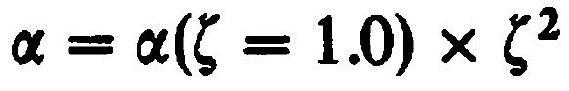
Basis sets
How do we extend the procedure to other 𝜁?
A change of 𝜁 leads to quadratic effect on ⍺
For example, a H atom in H₂ is described with 𝜁 = 1.24, the corresponding STO-3G fit is
vs the STO-3G GTO for 𝜁 = 1.00

Slide 13
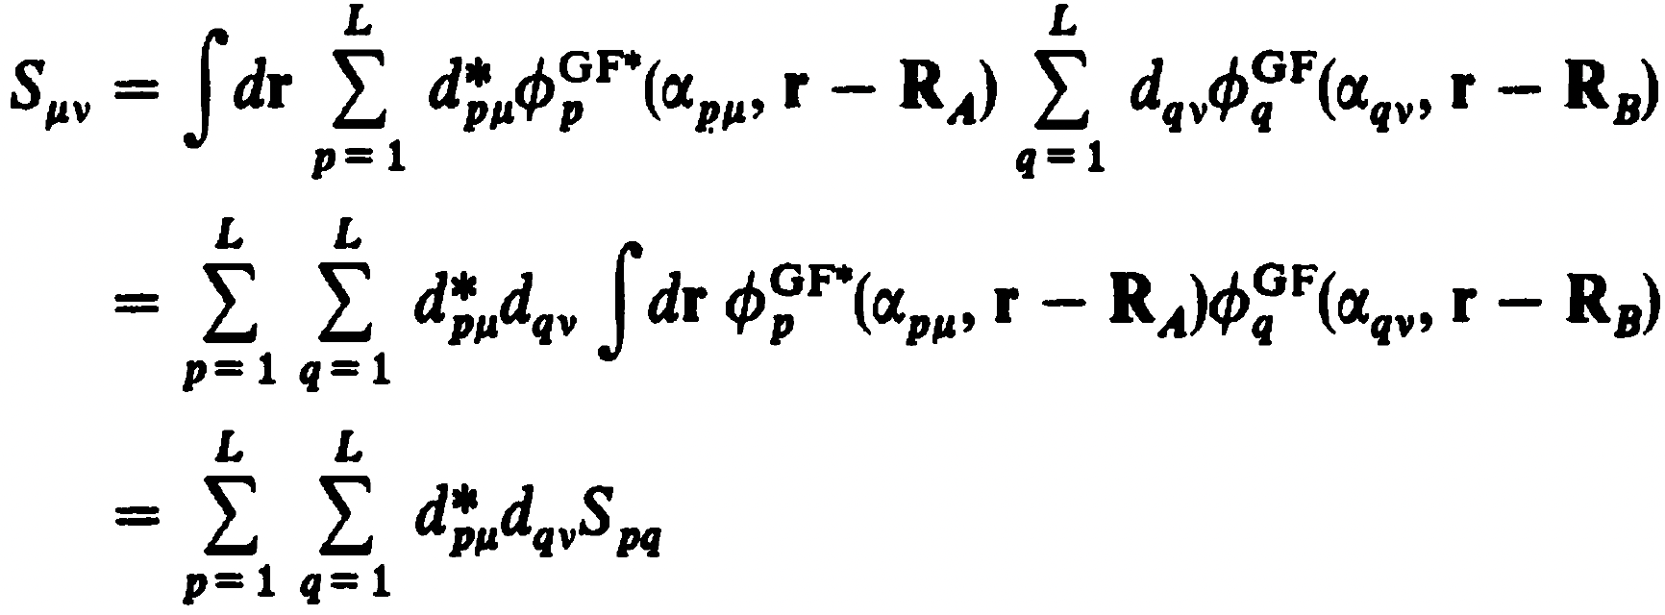
Basis sets
The overlap integrals using CGFs are then

Slide 14
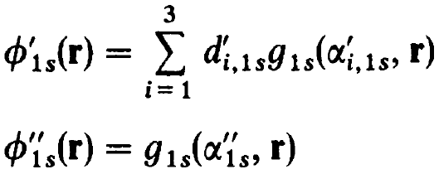
Split valence BS 4-31G
Use of multiple CGFs to discuss the valence electrons introduces more variational freedom.
For example, the valence orbital of H is described by two functions in the 4-31G basis set:
Similarly, 9 functions are used for the second row elements (1s + (2s + 2px + 2py + 2pz)*2), 13 functions are used for the third row elements (1s + 2s + 3 2p’s, + (3s + 3 3p’s)*2), and so on.

Slide 15
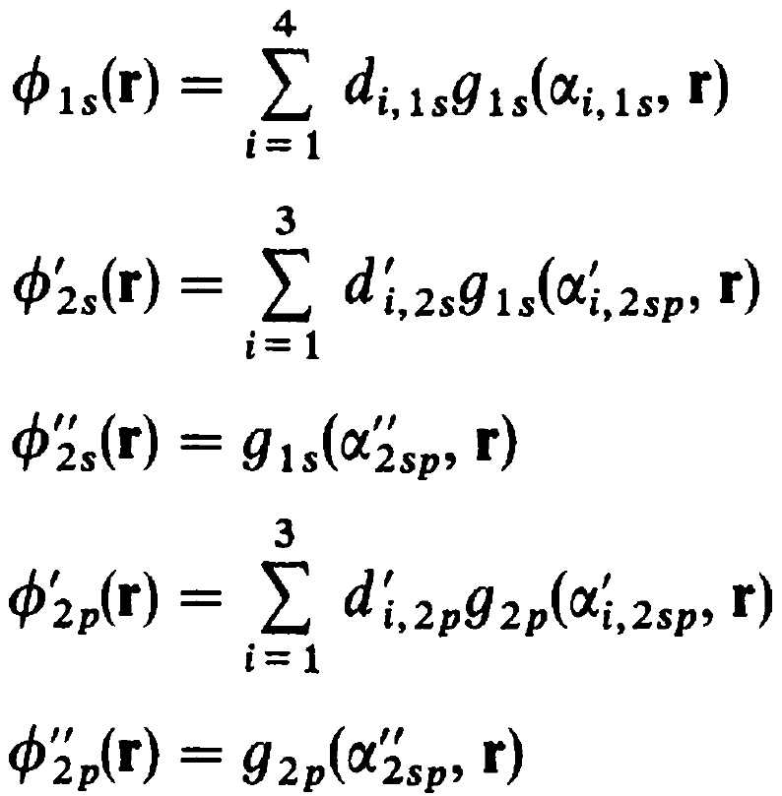
Split valence BS 4-31G
For Li to F
This contraction scheme is (8s4p/4s)/[3s2p/2s] (Li-F/H)

Slide 16
Polarization functions
We can continue adding more CGFs of the same symmetry to the orbitals. However, unlike isolated atoms, atoms in molecules experience asymmetric electric field. Therefore, to account for the non-uniform environment, higher angular functions need to be added to each shell. For example, p-type functions are added to the basis functions of hydrogen. This is called polarization function. In the Pople’s notation, a * is added to the end of the basis set of 6-31G (a double zeta basis set) to add polarization functions to non-hydrogen atoms and ** adds an additional polarization function to hydrogen.
Hence, the contraction scheme for 6-31G* is (11s4p1d/4s)/[4s2p1d/2s]

Slide 17
Some common basis sets
Pople’s basis sets
3-21G, 4-31G, 6-31G, 6-311G.
* and ** for polarizations. + and ++ for diffussion
Dunning’s correlation-consistent basis sets
cc-pVnZ, aug-cc-pVnZ, aug-cc-pCVnZ. n = D, T, Q, 5
Karlsruhe’s def2 basis sets
def2-SV(P), def2-SVP, -TZVP, -TZVPP, -QZVP, -QZVPP. D suffix for diffusion
Atomic natural orbital basis sets (not in pyscf)
ANO-pVnZ, aug-ANO-pVnZ (n = D, T, Q, 5)

Slide 18
Some common basis sets
Effective-core potential basis sets:
Los Alamos National Lab
LANL2DZ, LANL2TZ, LANL2TZ(f), LANL08
Dunning’s
(aug-)cc-p(C)VnZ-PP (n = D, T, Q, 5)
Stuttgart-Dresden
SDD

Slide 19
Interactive
Navigate to CompChem/Practice/Week3/Exercise1
Open basis_sets.ipynb
Fill in the required basis sets to test for Pople’s, Dunning’s, and Karlsruhe’s basis sets
Run the cells

Slide 20
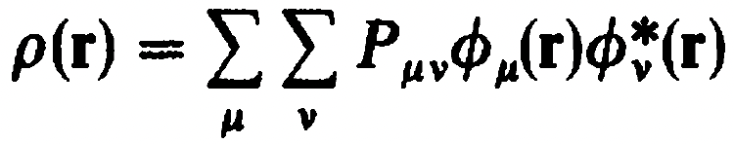
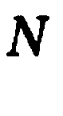
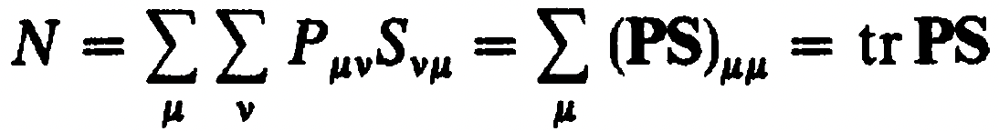
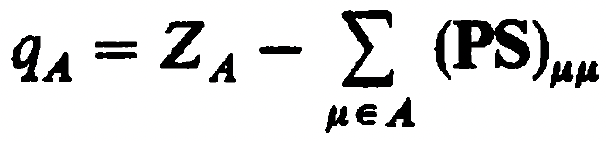
Population analysis
Recall that charge density is defined as
Rewrite using the definition of the overlap matrix
The net charge associated with an atom is thus
This definition is Mulliken’s definition of atomic charge.

Slide 21

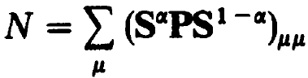
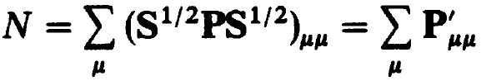
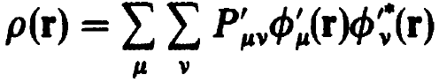
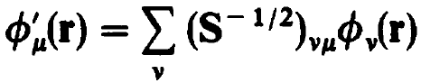
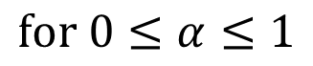
Population analysis
Since
We can rewrite
as
$$\text{for} 0≤α≤1$$
For $α=1/2$
which is the charge density in orthonormal basis

Slide 22
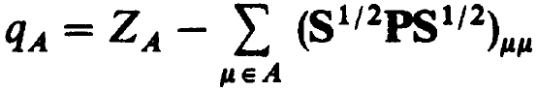
Population analysis
And the corresponding atom charge is
This definition is Loewdin’s definition of atomic charge.

Slide 23
Interactive
Navigate to CompChem/Practice/Week3/Exercise2
Open population_analysis.ipynb
Run the cells
What do you see?

Slide 24
Interactive
Navigate to CompChem/Practice/Week3/Exercise2
Open population_analysis_basis_set.ipynb
Fill in the definition of PS and PS_L
Run the cells

Slide 25
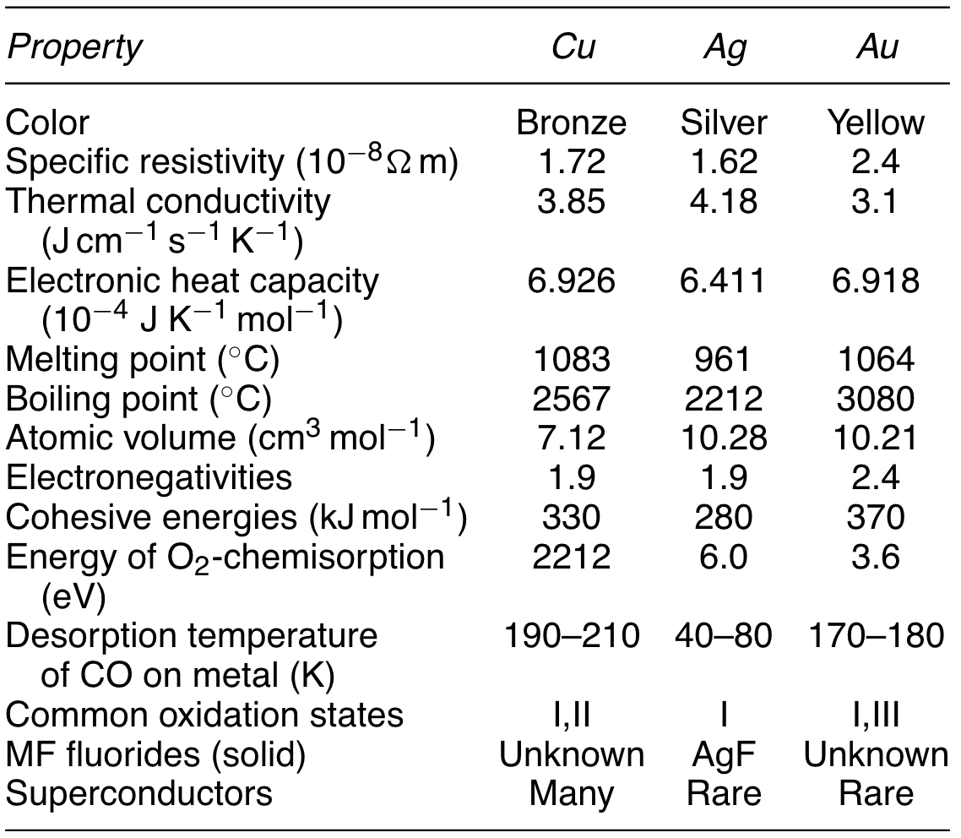
Relativistic effect
Schwerdtfeger, P. Relativistic effects in properties of gold. Heteroatom Chemistry 2002, 13 (6), 578–584

Slide 26
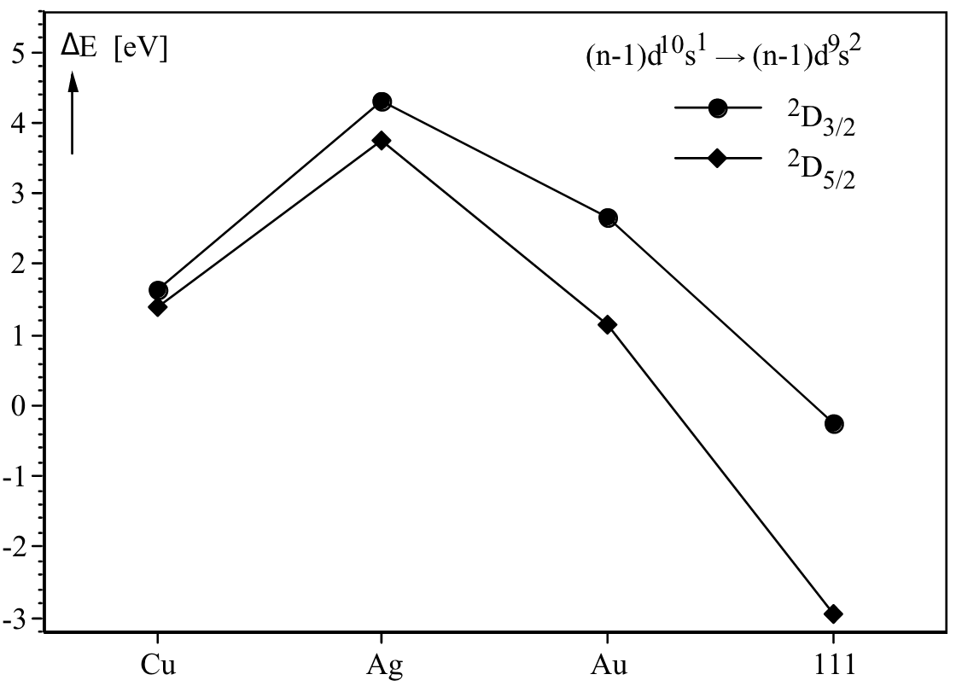
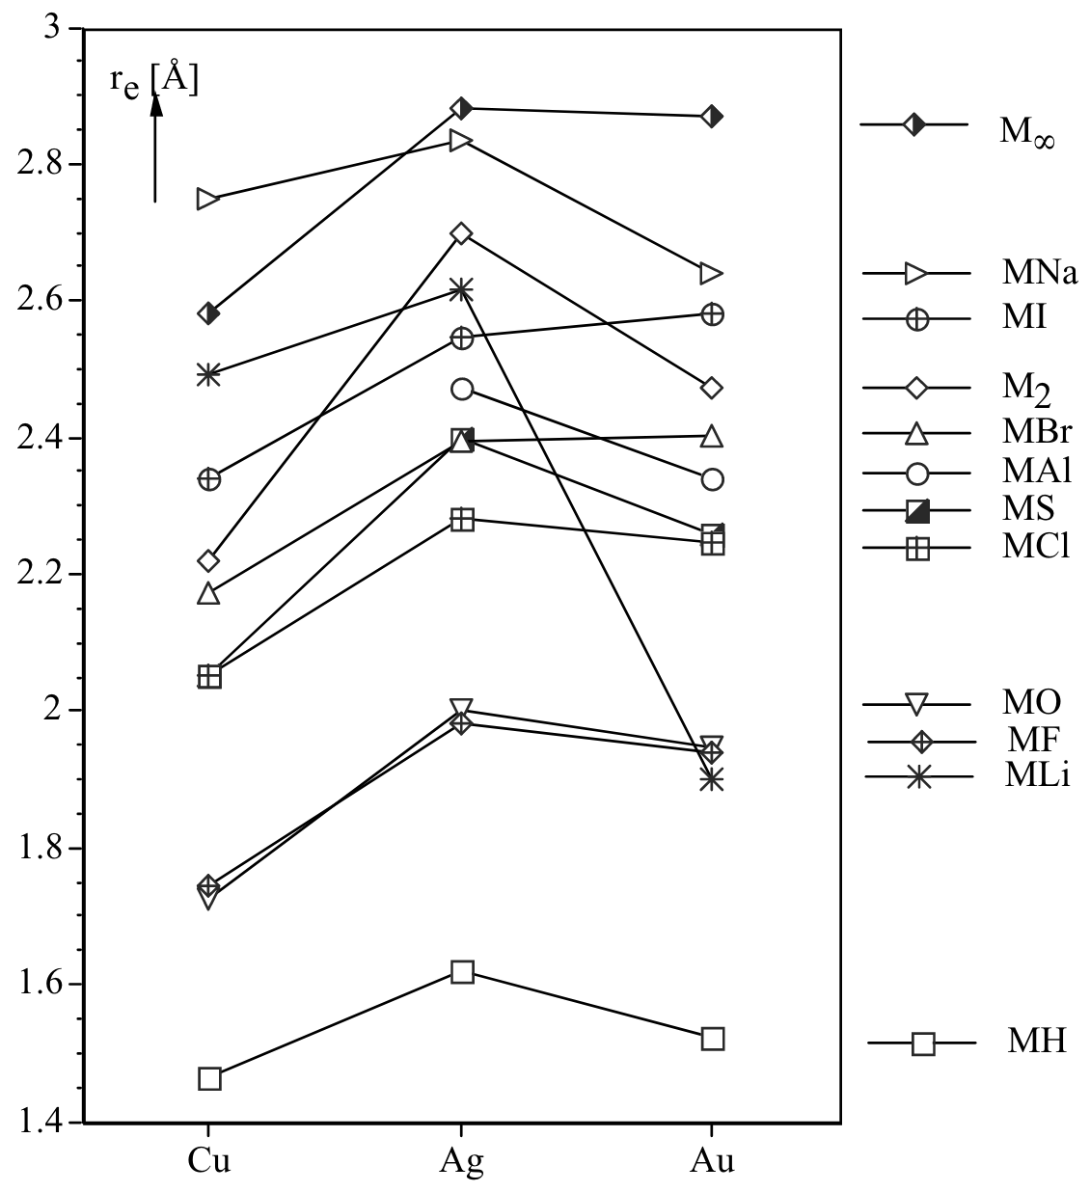
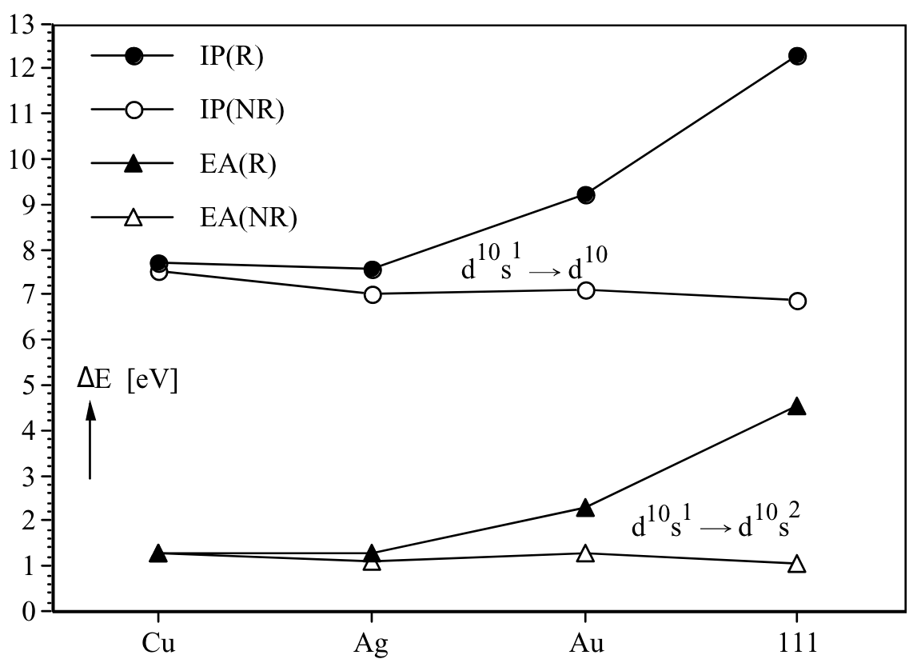
Relativistic effect
Schwerdtfeger, P. Relativistic effects in properties of gold. Heteroatom Chemistry 2002, 13 (6), 578–584

Slide 27
Relativistic corrections
There are three corrections to the non-relativistic Schrodinger’s equation, which can be separated into the scalar and the vectorial parts:
The scalar part:
Kinetic energy correction
Darwin term
The vectorial part:
Spin-orbit coupling

Slide 28
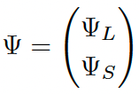
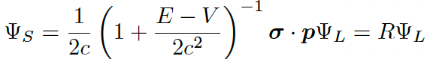
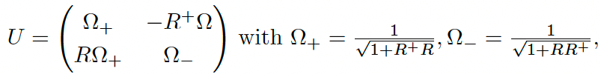
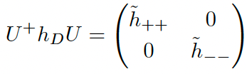
The relativistic equation
Dirac equation
The spinor can be decomposed,
,
The Hamiltonian can be unitarily transformed,
The large (electron) component satisfies

Slide 29
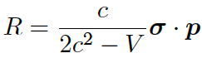
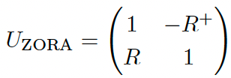
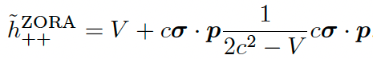
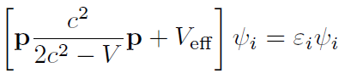

The regular approximation
The unitary matrix
Assuming that 1 >> R†R and 1 >> RR†,
The corresponding Hamiltonian, which is ZORA, is
The scalar relativistic ZORA equation is
with V_{eff} for DFT being

Slide 30







The regular approximation
However, ZORA is not gauge invariance under a constant change of V,
Replace the V in $\hat{T}$ with V_{model},
van Wüllen, C. Molecular Density Functional Calculations in the Regular Relativistic Approximation: Method, Application to Coinage Metal Diatomics, Hydrides, Fluorides and Chlorides, and Comparison with First-Order Relativistic Calculations. J. Chem. Phys. 1998, 109 (2), 392–399
where $ρ^{model}$ is the model density that serves as a good approximation for the density near the nucleus
,
The fit coefficients ($d_{i}$) were determined by near basis set limit scalar relativistic atomic HF calculations

